Slide 1
Neural Networks
Course 5: Improve Generalization

Slide 2
Overview
Other Activation Functions
Weight Initialization
Vanishing Gradient
Overfitting
Regularization
Dropout
Max Norm Constraint
Increase Dataset

Slide 3
Basic Neural Network Elements
Activation Functions

Slide 4

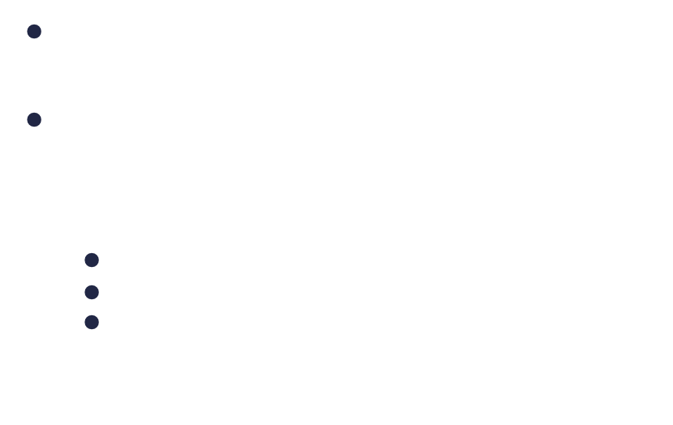
Activation Functions
Logistic :
y=1
$y=σ\left(z\right)=\frac{1}{1+e^{−z}}$
$σ^{′}\left(z\right)=x(1−x)$
Properties:
Always positive
The output is in the range 0 and 1
The gradient is very small at inputs outside [-4,4] interval
y=0.5
-6
-4
-2
2
4
6

Slide 5
Activation Functions
Logistic :
Advantages:
Since the output is [0,1] it is easy to represent probabilities
It’s form resembles the one of the binary threshold which make it similar to how we would think of a biological neuron
Used in binary classification with Binary Cross Entropy
Gradient is easy to compute y(1-y)
Disadvantages:
The output can be very close to zero. This can make learning very slow for neuron output values lower than -4
Computation during inference is more expensive. (compute exponential)

Slide 6
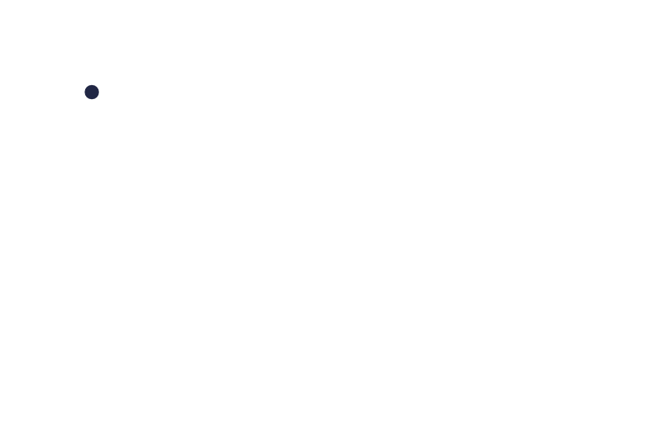

Activation Functions
Logistic :
Disadvantages (cont.):
The output is always positive:
all the weights of a neuron will be modified based on the sign of the error ($δ_{i}^{l}$). They either increase or decrease together
No gradient in
this quadrant
No gradient in
this quadrant
$$\frac{∂C}{∂w_{ki}^{l}}=δ_{i}^{l}∙y_{k}^{l−1}$$

Slide 7
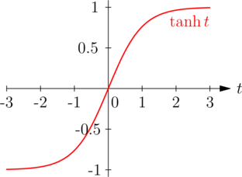
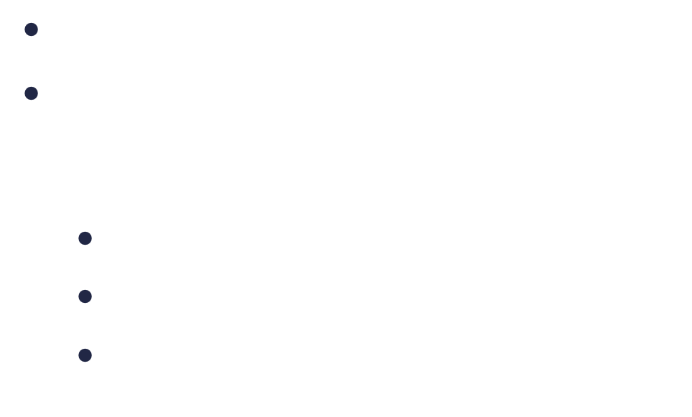
Activation Functions
Tanh (hyperbolic tangent):
tanh : $y=y=tanh\left(z\right)=\frac{e^{z}−e^{−z}}{e^{z}+e^{−z}}=2σ\left(2z\right)−1$
$tanh^{′}(z)=1−\tanh^{2}⁡(z)$,
Properties:
It is zero centered
The output is in the range -1 and 1
The gradient is very small at inputs outside [-2,2] interval
Source: https://medium.com/machine-intelligence-report/how-do-neural-networks-work-57d1ab5337ce
Notes:
This non-linearity allows the network to learn and represent more complex patterns and functions, enabling it to solve a wider range of problems.
By applying a non-linear function to the output of each neuron, the network can learn intricate patterns in the data, such as the XOR problem, which cannot be solved using a linear model.
Ensure Differentiability: without it wwe wouldn’t know the move and the direction in which we should move
Example: a lnear transformatopm

Slide 8
Activation Functions
tanh :
Advantages:
Has steeper gradients in the interval [-1, 1]. This can make learning faster
It outputs both positives and negatives value. During backpropagation the sign of gradient of each weight can be different.
Used in weighting information
Disadvantages:
Computation during inference and training is more expensive.

Slide 9
Weight Initialization

Slide 10
Weight Initialization
Even if the network learns the weights, the initial value of the weights is important since these dictate how fast and to which local minimum the weights converge
The loss surface of a deep neural network, with many layers and many dimensions is complex and not convex. Choosing a good starting point is important.
The main initialization methods available are:
* LeCun Initialization
* Xavier or Glorot
* He Initialization

Slide 11
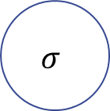
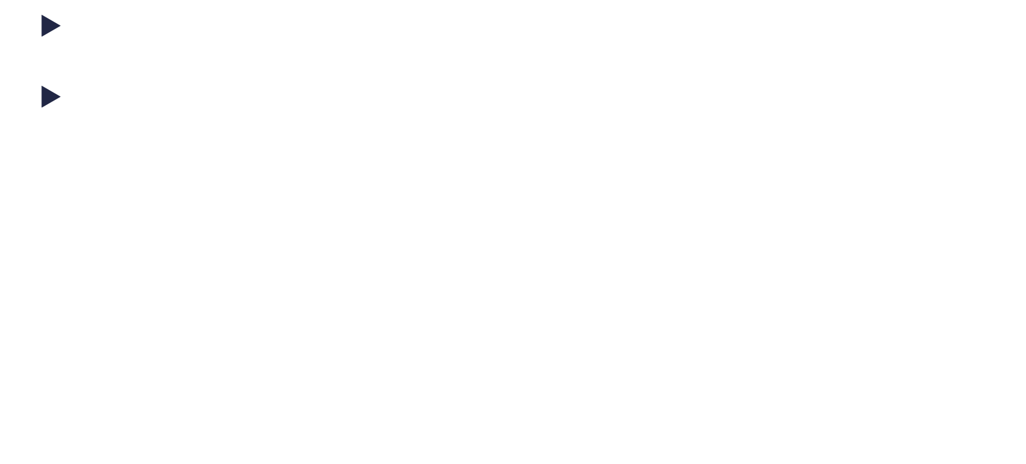
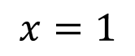
Weight Initialization
Why do we need to initialize weights with random values?
What if we would initialize all of them with 0s? (logistic activation)
$z_{i}^{l}=wx+b=0x+0=0$
$σ\left(z_{i}^{l}\right)=σ\left(0\right)=\frac{1}{1+e^{0}}=0.5$
(similarly), ${σ(z}_{i}^{L})=0.5$
Whatever the input, the output will be the same
$$z_{i}^{L}$$
$$z_{i}^{l}$$

Slide 12


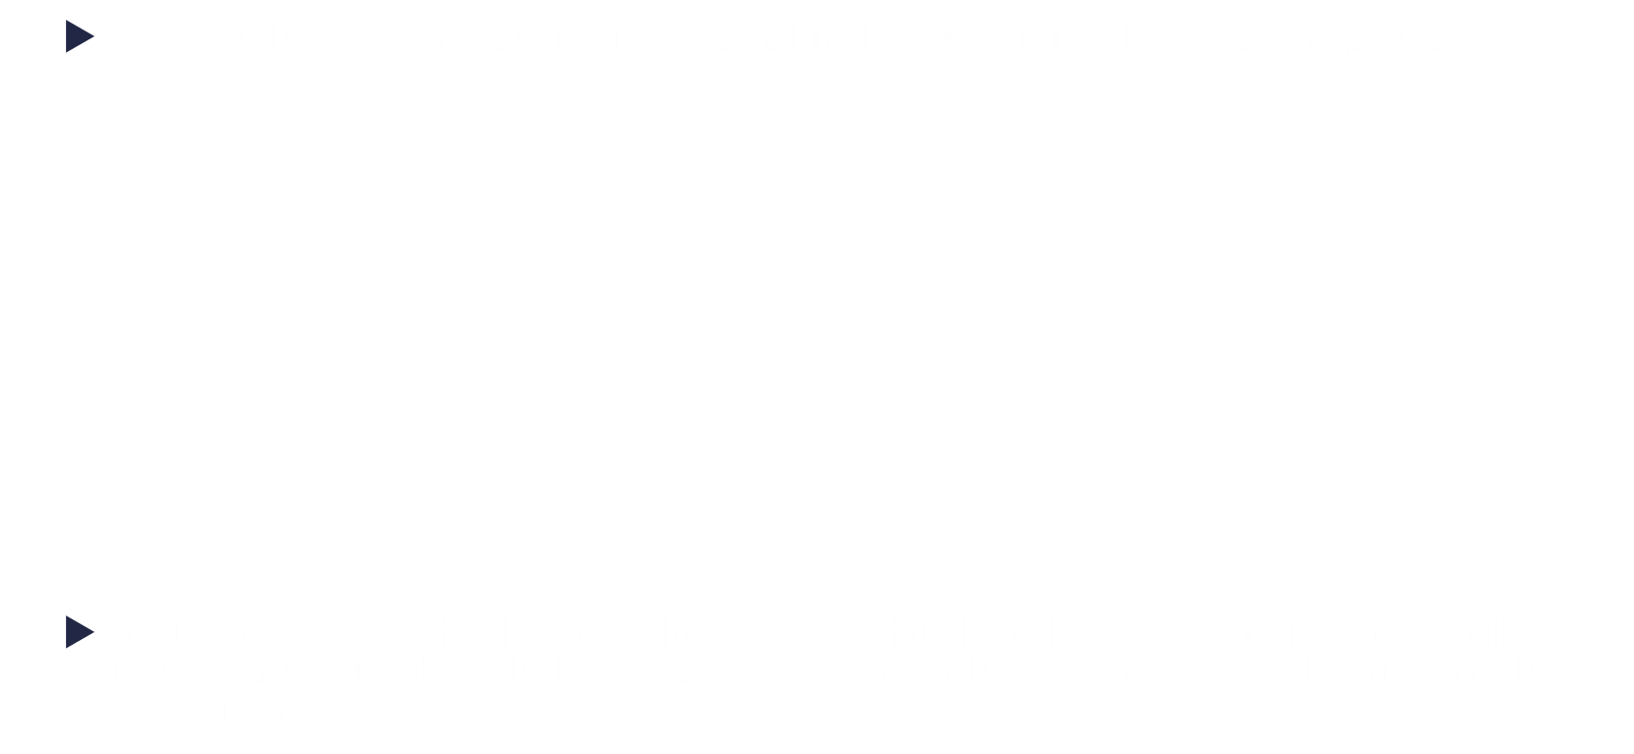
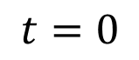
Weight Initialization
What if we would initialize all of them with 0s?
The error at the final layer, when computing backpropagation,(if cross entropy is used ), will be:
$t−0.5=±0.5$
The error that will be backpropagated, will be: $δ_{i}^{l}=y_{i}^{l}\left(1−y_{i}^{l}\right)\sum_{k}{δ_{i}^{l+1}∙w_{ik}^{l+1}}=$
$0.5∗\left(1−0.5\right)∗\left(δ^{L}∗0\right)=0$
y=0.5
$$z_{i}^{L}$$
$$y_{i}^{l}=0.5$$
$$z_{i}^{l}$$

Slide 13

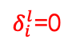
Weight Initialization
What if we would initialize all of them with 0s?
The network will adjust the weights in the final layer $w^{2}$, with the same amount for each weight
$$w=w+η∗δ_{i}^{L}y^{l−1}=0+η∗±0.5∗0.5$$
$$b=b+{η∗δ}_{i}^{L}=0+η∗±0.5$$
The lower layers will not learn on this iteration since the error $δ_{i}^{l}$ is zero.
y=0.5
$$z_{i}^{L}$$
$$y_{i}^{l}=0.5$$
$δ_{i}^{l}$=0
$$z_{i}^{l}$$

Slide 14

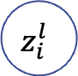


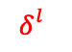
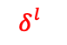

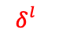
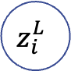

Weight Initialization
On the next iteration, the error at the final error will depend on the label and we will also have an error backpropagated.. $δ_{i}^{l}=y_{i}^{l}\left(1−y_{i}^{l}\right)\sum_{k}{δ_{i}^{l+1}∙w_{ik}^{l+1}}$
Since each weights has the same value, and each neuron in the layer has the same activation, so is the error
$$δ_{i}^{l}=y_{i}^{l}\left(1−y_{i}^{l}\right)n_{in}{δ_{i}^{l+1}w}_{ik}^{l+1}$$
$$y^{L}=σ(n_{in}∗η∗\left(±0.25\right))$$
$$z_{i}^{L}$$
$$w_{i}^{l}=η∗0.25$$
$$w_{i}^{l}=η∗0.25$$
$$y_{i}^{l}=0.5$$
$$z_{i}^{l}$$
$$δ_{}^{l}$$
$$δ_{}^{l}$$
$$δ_{}^{l}$$

Slide 15

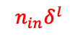

Weight Initialization
So, even though we have multiple neurons in the hidden layer, they will always have the same weights and same activation (at layer level).
Is almost as there is only one neuron in the hidden layer
It’s more efficient to just increase a learning rate and have a single neuron.
$$y^{L}$$
$$z_{i}^{L}$$
$${n_{in}δ}^{l}$$
$${n_{in}y}^{l}$$

Slide 16
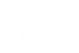




Weight Initialization
What if we would initialize all of them with a constant (different than 0)?
$$z_{i}^{L}$$
$$c^{}$$
$$c^{}$$
$$c^{}$$
$$z_{i}^{l}$$
$$c^{}$$
$$c^{}$$

Slide 17


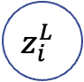

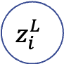
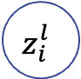


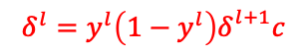
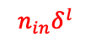


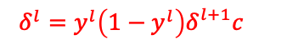

Weight Initialization
What if we would initialize all of them with a constant (different than 0)?
It is the same scenario as initializing them with 0, it is just that we’ve skipped the first iteration.
The error and activations are different than the ones obtained by initializing with zero, but they are still the same across neurons from the same layer
$$y^{L}$$
$$y^{L}$$
$$z_{i}^{L}$$
$$z_{i}^{L}$$
$$δ^{l}=y^{l}\left(1−y^{l}\right)δ_{}^{l+1}c$$
$${δ^{l}=y^{l}\left(1−y^{l}\right)δ_{}^{l+1}c}^{}$$
$$y^{l}$$
$$c^{}$$
$$y^{l}$$
$${n_{in}δ}^{l}$$
$$y^{l}$$
$${n_{in}y}^{l}$$
$$z_{i}^{l}$$
$$c^{}$$

Slide 18
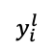
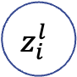

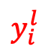

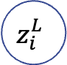
Weight Initialization
So , to increase the change of the neurons learning different features we need to initialize the weights using random variables
Each neuron will produce a different output, which might be bigger on certain inputs, which will drive a bigger gradient, thus creating a feature detector.
$$z_{i}^{L}$$
$$y_{i}^{l}$$
$$z_{i}^{l}$$
$$y_{i}^{l}$$
$$y_{i}^{l}$$
$$\frac{∂C}{∂w_{ki}^{l}}=δ_{i}^{l}∙y_{k}^{l−1}$$

Slide 19


Weight Initialization
What if we initialize the weights using a standard normal distribution. (normal distribution with $σ=1$ and $μ=0$ $𝒩(0,1)$)
That means that 68% of the weights have values in interval [-1,1], 95% have values in interval [-2,2], 99.3 in [-3,3]

Slide 20
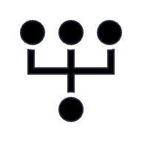


Weight Initialization
We will make an experiment:
We will consider a neural network with 5 layers
50→50
50→50
50→50
50→50
50→50
$$\left[\begin{matrix}{input}_{1} \\ {input}_{2} \\ \begin{aligned}⋮ \\ {input}_{50}\end{aligned}\end{matrix}\right]$$
Input Layer
Hidden Layers
Output Layer

Slide 21
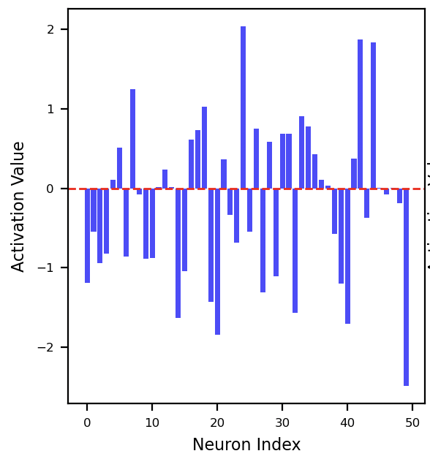

Weight Initialization
We will make an experiment:
For each layer we will plot the activation value: the value after application of the activation function (tanh) over the weighted input.
We will generate an input with 50 values generated random using $𝒩(0,1)$
An example of an input plot

Slide 22
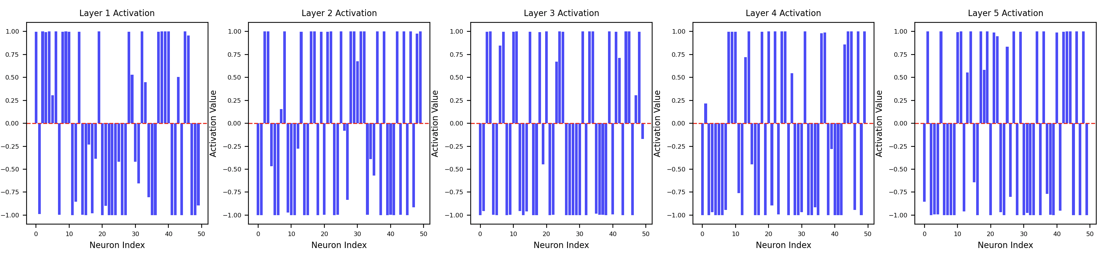
Weight Initialization
Observations :
The activations for each layer is almost every time -1 or 1.
The number of activations that output the maximum value increases from layer to layer

Slide 23
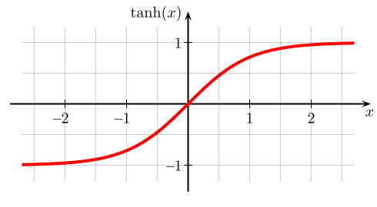
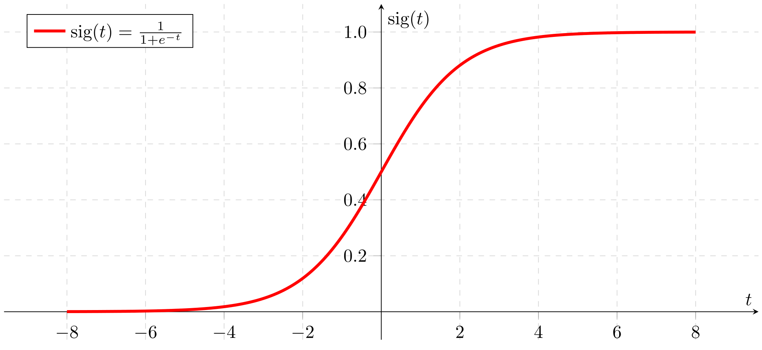
Weight Initialization
The problem with the activations being on extremes is that the gradient, that is needed in modifying the weights , is very small.
Thus, the learning will be very small. The neuron “saturates” on large activation values

Slide 24


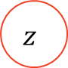



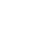




Weight Initialization
The reason this happens is because a neuron computes a weighted sum of the input $z=\sum_{x}{wx+b}$
Let’s see what happens for a neuron with 50 inputs.
$$x_{o}\sim 𝒩(0,1)$$
$$x_{1}\sim 𝒩(0,1)$$
$$w_{1}^{}$$
$$w_{0}^{}$$
$$z$$
$$……….$$
$$w_{49}^{}$$
$$b$$
$$x_{49}\sim 𝒩(0,1)$$
$$1$$

Slide 25


Weight Initialization
That means that the net input$z=\sum_{i=0}^{49}{w_{i}}$+b
Since $w_{i}$ and $b$ are normally distributed, that means that:
$μ_{z}=\sum_{i=0}^{49}{{μ_{w}}_{i}}+μ_{b}=0$
It can be shown that for two independent random variables x, y, with mean 0, the variance of their product var(x*y)=var(x)*var(y):
$var\left(z\right)=\sum_{i=0}^{49}{var\left(w_{i}\right)var(x_{i})}+var\left(b\right)=51$. So $σ≈7.14$
$$var\left(z\right)=var(\sum_{i=0}^{49}{var(w_{i}x_{i})}+var\left(b\right)$$

Slide 26

Weight Initialization
That means that
* 68% of z in [-7.14, 7.14].
* 95% of z in [-14,14]
This is a big interval for neurons that saturate for values outside [-2,2]
The neurons from the first second layer will also receive a greater input which will lead to greater variance for the next layer
-14.28
-7.14
7.14
14.28

Slide 27
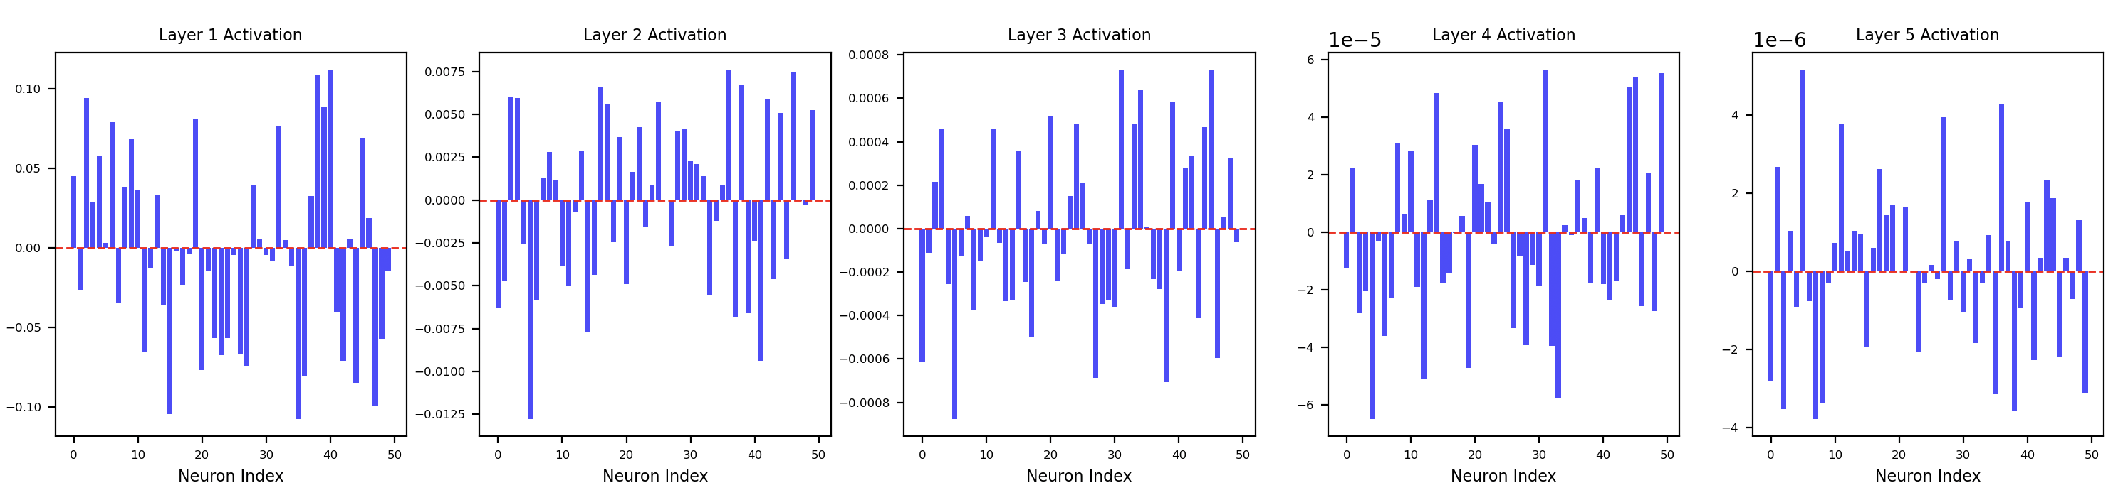

Weight Initialization
Since bigger weights lead to large values in the weighted sum of the input, one might think that very small weights solve the problem.
So we will repeat the experiment, this time generating weights from a normal distribution: $𝒩(0,0.01)$

Slide 28

Weight Initialization
Observations:
Using very small values for the weights, leads to decreasing small activations in the upper layers.
When computing the gradient we take into account the activation value as well
So, we get into a situation where the network can’t learn since the weight updates are too small
$$\frac{∂C}{∂w_{ki}^{l}}=δ_{i}^{l}∙y_{k}^{l−1}$$

Slide 29

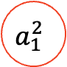






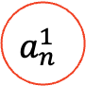


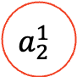
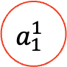


Weight Initialization
A better strategy for weight initialization:
$$var\left(a_{1}^{1}\right)=var(\sum_{i=1}^{n}{var\left(w_{i}^{1}x_{i}\right)}$$
= $n var\left(w\right)var\left(x\right)$
$$var\left(a_{1}^{2}\right)=n var\left(w_{}^{2}\right)var\left(a_{}^{1}\right)$$
$=n var\left(w\right)\left[n var\left(w\right)var(x_{})\right]$
$=n^{2} var\left(w^{2}\right)var(x_{})$
$={\left[n var\left(w\right)\right]}^{2} var(x)$
$$x_{o}\sim 𝒩(0,1)$$
$$w_{11}^{1}$$
$$a_{1}^{1}$$
$$w_{11}^{2}$$
$$a_{1}^{2}$$
$$x_{1}\sim 𝒩(0,1)$$
$$w_{12}^{1}$$
$$w_{11}^{2}$$
$$……….$$
$$a_{2}^{1}$$
$$x_{n}\sim 𝒩(0,1)$$
$$w_{1n}^{1}$$
$$…$$
$$w_{n1}^{2}$$
$$a_{n}^{1}$$
Notes:
Am presupus aici ca toate weighturile si x_1 au aceasi varianta

Slide 30

Weight Initialization
A better strategy for weight initialization:
For a layer k and a neuron i, the variance will be:
$var\left(a_{i}^{k}\right) ={\left[n var\left(w\right)\right]}^{k} var(x)$
To make sure that the variance doesn’t explode , nor it diminishes , $n var\left(w\right)$must be 1
$var\left(w\right)=\frac{1}{n}$
So, the weights must be initialized using
$μ=0$ and $σ =\frac{1}{\sqrt{n}}$
Notes:
Am presupus aici ca toate weighturile si x_1 au aceasi varianta

Slide 31
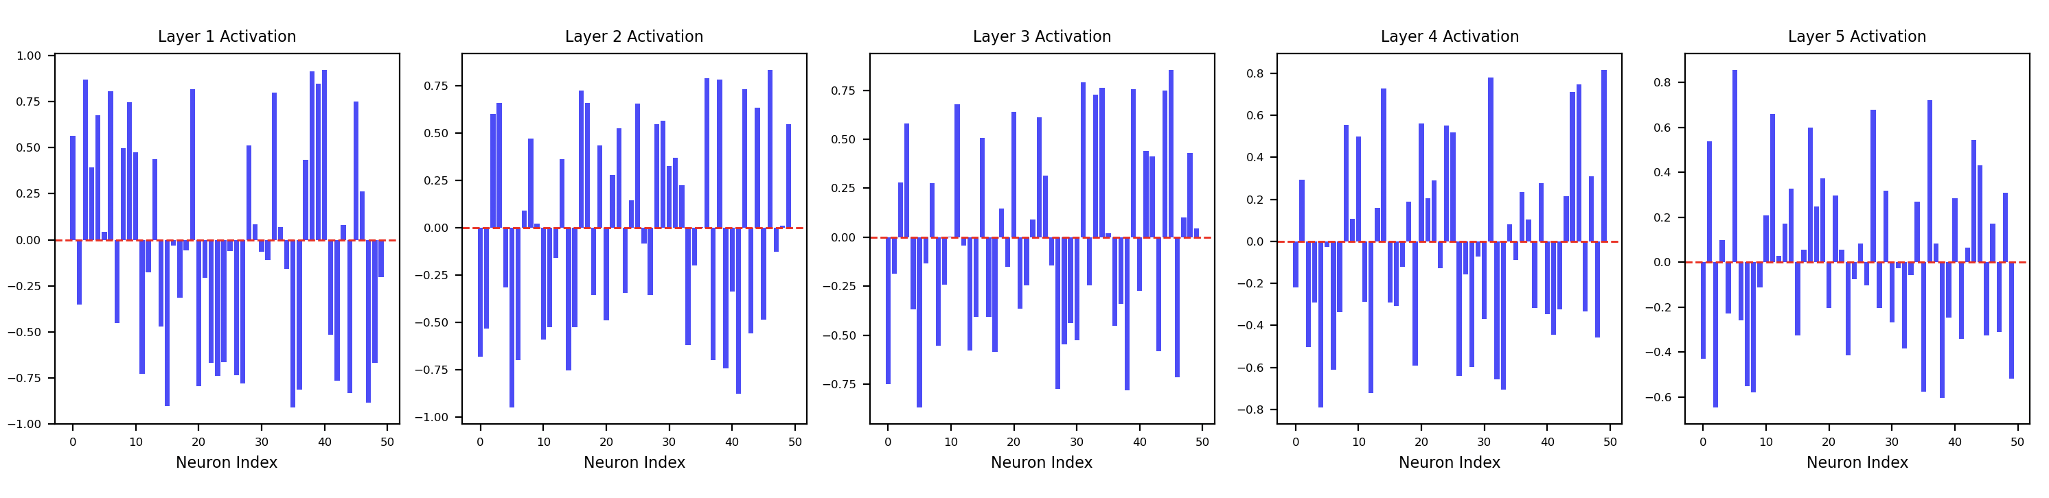

Weight Initialization
Activation values for each layer initialized using a normal distribution with mean 0 and stdev = $\frac{1}{\sqrt{n}}$
This is called LeCun initialization
For a 5-layer network activation values have consistent values

Slide 32
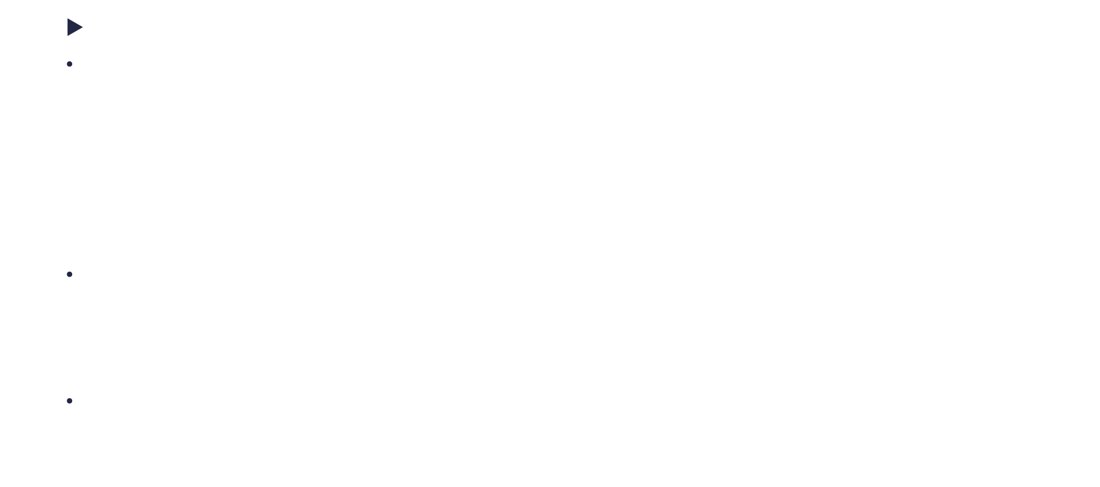
Weight Initialization
A better strategy for weight initialization:
An improvement of this strategy was proposed by X. Glorot and Y. Bengio
Backpropagation of error:
$$δ_{i}^{l}=\frac{∂C}{∂z_{i}^{l}}=a^{′}\left(z_{i}^{l}\right)\sum_{k}{w_{ik}^{l+1}⋅δ_{k}^{l+1}}$$
When backpropagating the error, we compute a weighted sum over the error. We can see this as a ”neural network” where the input is the error at the output layer, and goes from output to input.
However, for a neuron, the number of output weights is not necessary the same as the nr of input weights. So they were initialized using a different variance
Notes:
Daca ne uitam, avem acelasi caz.. Suma de wx, dar de data asta e suma de w*delta. Deci si in sens invers avem aceasi problema.. Gradientul dispare.. Pentur a nu avea problema asta,trebuie sa tinem cont si de numarul de iesiri din fiecare neuron.

Slide 33

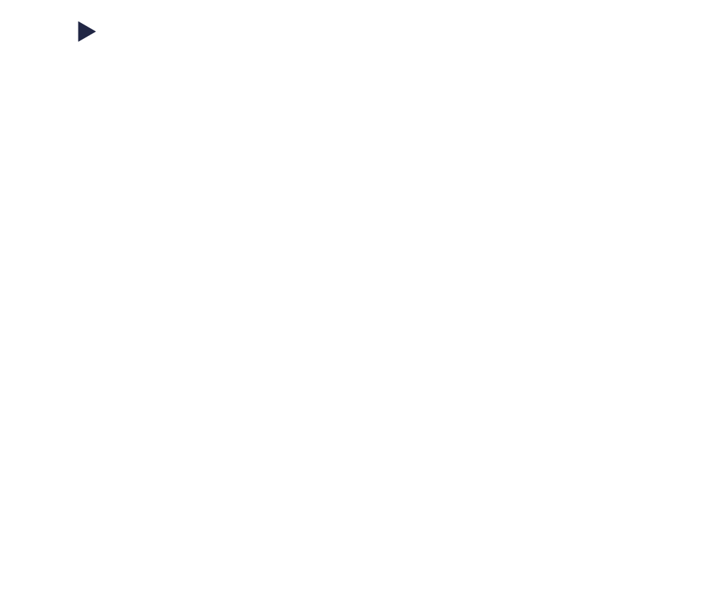




Weight Initialization
A better strategy for weight initialization:
Instead of taking into account just $fan_{in}$, the authors suggest to use the mean of $(fan_{in}+fan_{out}$) :
$$\frac{\left(fan_{in}+fan_{out}\right)}{2}var\left(w\right)=1$$
So, the weights should be initialized using a normal distribution and :
This is called xavier normal initialization
$$fan_{in}$$
$$fan_{out}$$
$$fan_{in}=nr of weights going$$
$in the neuron$
$μ=0$ and $σ =\sqrt{\frac{2}{fain_{in}+fan_{out}}}$
$$fan_{out}=nr of weights going$$
$out of the neuron$

Slide 34
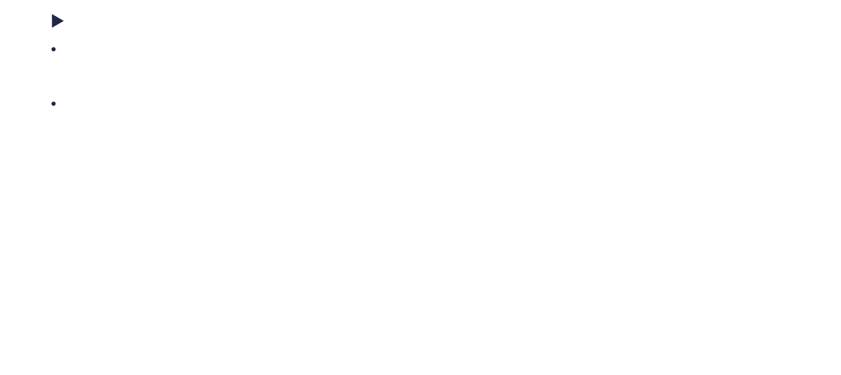
Weight Initialization
A better strategy for weight initialization:
The weights can also be initialized using a uniform distribution
The variance of a random variable x that is generated from a uniform distribution from the interval [a, b] has the variance:
$$var\left(x\right)=\frac{{\left(b−a\right)}^{2}}{12}$$
Since we want mean 0, we will consider generating x from interval [-a,a].
So the variance will be:
$$var\left(x\right)=\frac{{\left(a−(−a)\right)}^{2}}{12}=\frac{4a^{2}}{12}=\frac{a^{2}}{3}$$

Slide 35
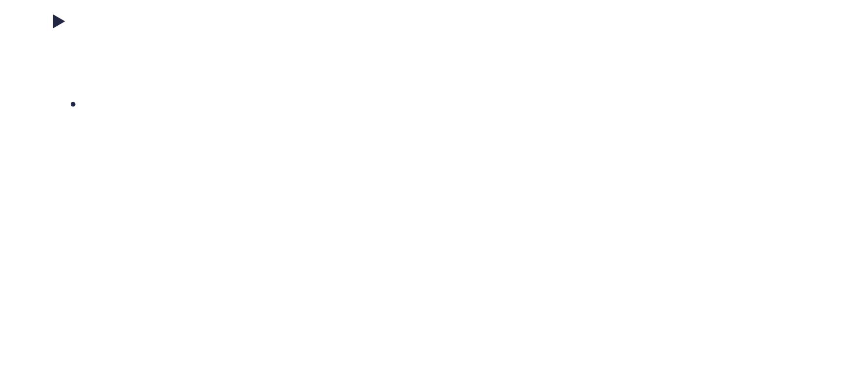
Weight Initialization
A better strategy for weight initialization:
Xavier Uniform
Since we want $var\left(x\right)=\frac{2}{fan_{in}+fan_{out}}$ from a uniform distribution then $var\left(x\right)=\frac{a^{2}}{3}$
$\frac{a^{2}}{3}=\frac{2}{fan_{in}+fan_{out}}$=> $a=\sqrt{\frac{6}{fan_{in}+fan_{out}}}$
So we should initialize weights using a random uniform distribution with the interval
$\left[− \sqrt{\frac{6}{fan_{in}+fan_{out}}}\text{, }\sqrt{\frac{6}{fan_{in}+fan_{out}}} \right]$
Notes:
In practica nu sunt diferente mari. Normal concenteraza mai mult valori spre zero,ceea ce e posibil ca varianta gradientilor sa scada.
Unfiorm, fiindca gradientii ar fi mai mari, e posibil sa duca spre o invatare mai rapida si o disparitie mai lenta a gradientilor. Am putea folosi normal atunci cand reteaua e mai mica... Deci in teorie xavier normal ar merge mai ok un learning rate mai amre

Slide 36
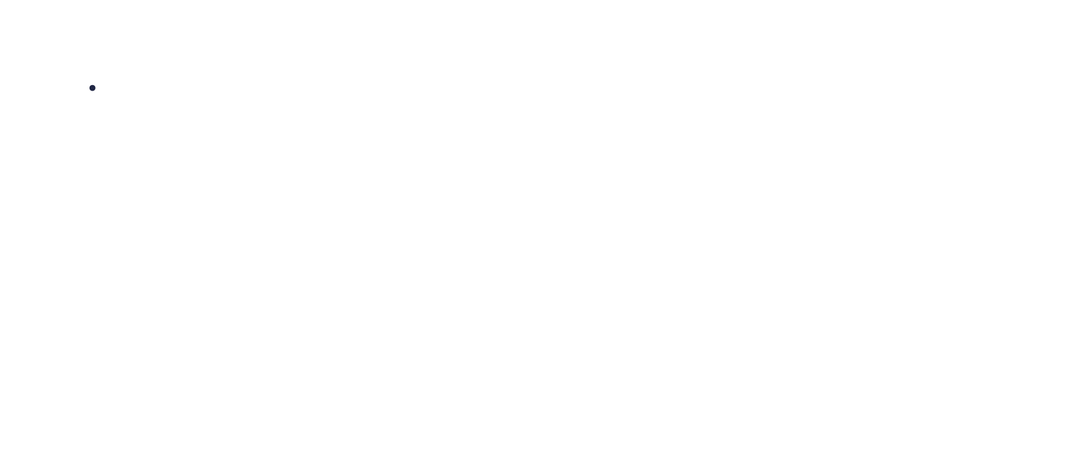
Weight Initialization
LeCun uniform distribution
Since we want $var\left(x\right)=\frac{1}{fan_{in}}$ from a uniform distribution then $var\left(x\right)=\frac{a^{2}}{3}$
$\frac{a^{2}}{3}=\frac{1}{fan_{in}}$=> $a=\sqrt{\frac{3}{fan_{in}}}$
So we should initialize weights using a random uniform distribution with the interval
$\left[− \sqrt{\frac{3}{fan_{in}}}\text{, }\sqrt{\frac{3}{fan_{in}}} \right]$
LeCun initialization is rarely used in practice. Xavier(Glorot) is preferred over LeCun.
Notes:
In practica nu sunt diferente mari. Normal concenteraza mai mult valori spre zero,ceea ce e posibil ca varianta gradientilor sa scada.
Unfiorm, fiindca gradientii ar fi mai mari, e posibil sa duca spre o invatare mai rapida si o disparitie mai lenta a gradientilor. Am putea folosi normal atunci cand reteaua e mai mica... Deci in teorie xavier normal ar merge mai ok un learning rate mai amre

Slide 37
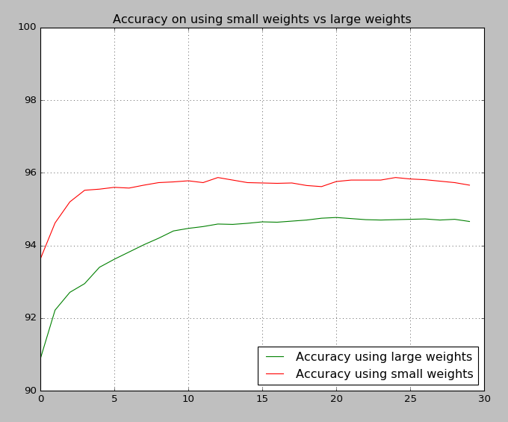
Weight Initialization
By using small weights, the network accuracy increases
Also, using small weights, the network arrives faster at the best accuracy

Slide 38
Vanishing Gradient

Slide 39
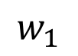
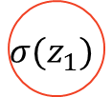


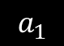
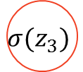



Vanishing Gradient
Let’s suppose we have the following network :
If we want to find out how to modify $w_{1}$ we have to compute the $\frac{∂E}{∂w_{1}}$
$\frac{∂E}{∂w_{1}}=\frac{∂E}{∂_{output}}∙\frac{∂output}{∂z_{3}}∙\frac{∂z_{3}}{∂a_{2}}∙\frac{∂a_{2}}{∂z_{2}}∙\frac{∂z_{2}}{∂a_{1}}∙\frac{∂a_{1}}{∂z_{1}}∙\frac{∂z_{1}}{∂w_{1}}=$
$=\frac{∂E}{∂output}∙σ^{′}\left(z_{3}\right)∙w_{3}∙σ^{′}\left(z_{2}\right)∙w_{2}∙σ^{′}\left(z_{1}\right)∙input$
$$w_{1}$$
$$w_{2}$$
$$w_{3}$$
$$σ(z_{1})$$
$$σ(z_{2})$$
$$σ(z_{3})$$
input
$$a_{1}$$
$$a_{2}$$
output
error

Slide 40




Vanishing Gradient
$\frac{∂E}{∂w_{1}}=\frac{∂E}{∂output}∙σ^{′}\left(z_{3}\right)∙w_{3}∙σ^{′}\left(z_{2}\right)∙w_{2}∙σ^{′}\left(z_{1}\right)∙input$
All the gradients are sub unitary. Many times, so are the weights. Think of how they are initialized.
<1
<1
<1
<1
<1
Graph of logistic $σ′$
Graph of tanh’

Slide 41

Tanh activation
For a more complex network, with many neurons on each layer, the error is back propagated by the formula:
$$δ_{i}^{l}=σ′(z_{i}^{l})\sum_{k}{δ_{i}^{l+1}∙w_{ik}^{l+1}}$$
Even if the weighted sum of the error might have variance of 1, the gradients of the activation function still diminishes the error with each layer
Before having a weight initialization method, the method was exacerbated

Slide 42
Vanishing Gradient
This makes the error that reaches the lower layers very small, depending on the number of layers
This makes the lower layers adapt very slowly, and with it the entire network, since the upper layers depend on the ones below
Layer 2
Layer 3
Layer 1
Layer 4

Slide 43
Relu Activation

Slide 44


ReLU
Rectified linear unit
$$relu\left(x\right)=\left\{\begin{aligned}0, if x<0 \\ x, if x≥0\end{aligned}\right.=max(0, x)$$
$$relu′\left(x\right)=\left\{\begin{aligned}0, if x<0 \\ 1, if x≥0\end{aligned}\right.$$
Properties:
It is not derivable at 0, but we’ll just consider 0 for that case
The output is always positive
The gradient is constant: 1 or 0

Slide 45


ReLU
Rectified linear unit
Relu is linear by parts $(−∞,0]$ and $[0,+∞)$, but overall Relu is not linear.
A function is linear if $f\left(x\right)+f\left(y\right)=f\left(x+y\right)$ which is not true for two value of different sides of 0
This means that combinations of ReLU is not a linear function, but a more complex shape
Source: https://medium.com/machine-intelligence-report/how-do-neural-networks-work-57d1ab5337ce

Slide 46
ReLU
Advantages:
Having constant gradients, it does not contribute to the vanishing gradient problem
ReLU encourages sparsity in the network. Since it outputs zero for all negative inputs, many neurons will be inactive (i.e., have an output of zero) n. for any given input.
Very fast to compute both on feedforward and backpropagation side
Relu and its variants is the most widely used activation function

Slide 47

ReLU
Sparsity
Sparsity means to have the size of the feature vector larger than the size of input, but only a fraction of the feature vector is activated for an input
So a neuron will activate only in some
Inputs
ReLU encourages sparsity, since with a
weight initialization of mean 0, half of the
neurons will output 0
Source: Deep Sparse Rectifier Neural Networks , Xavier Glorot, Antoine Bordes, Antoine Bordes
Notes:
Sparsity is implemented since the neuron can output a true zero.
Sparsity is a nice way of avoiding overfitting

Slide 48
ReLU
Sparsity. Advantages:
Specialized features:
When a neuron fires only on some certain input it effectively becomes specialized in detecting the input
More likely to be linear separable,
The next layer may contain more features than the previous, thus transforming the data into a multidimensional space where it might become separable
Reduced Redundancy:
Neurons might develop complementary features instead of redundant ones leading to a more diverse set of features
Source: Deep Sparse Rectifier Neural Networks , Xavier Glorot, Antoine Bordes, Antoine Bordes
Notes:
Other advantages: Regularization
Other advantages: Easier understanding of the data through the network

Slide 49
ReLU
Disadvantages:
It is unbounded: can lead to exploding activations. This can be resolved by clipping the activation value. (i.e. ReLU6)
Not zero centered and it doesn’t output negative values
Dying ReLU: which can lead to slow learning after many iterations

Slide 50



ReLU
Dying ReLU:
A dying ReLU outputs 0 on any input value.
From backpropagation, we know that the weights are updated based on the computed error:
$$δ_{i}^{l}=a′(z_{i}^{l})\sum_{k}{δ_{i}^{l+1}∙w_{ik}^{l+1}}$$
$$\frac{∂C}{∂w_{ki}^{l}}=δ_{i}^{l}∙y_{k}^{l−1}$$
$$w_{ki}^{l}=w_{ki}^{l}−η\frac{∂C}{∂w_{ki}^{l}}$$
The error at that neuron will always be zero and so the gradient. So its weights will not get modifies. The neuron … dies
Notes:
Daca avem un neuron care da output-ul zero pentru toate inputurile , atunci toate eoririle care ajung la el sunt zero , iar neuronal nu mai invata.. moare

Slide 51
ReLU
Dying ReLU:
Some of the reasons why this happen are:
Large learning rate: if the error is negative, then a large learning rate might make a sufficient number of weights negative.
Imbalanced input distribution: The data might be distributed towards negative values. Normalization is recommended
Poor weight initialization: large weight updates might lead to large error, thus performing large updates (which might be negative)

Slide 52



ReLU
Other variants of rely have appeared that solve most of the problems by introducing a small slope for negative inputs:
Leaky Relu :
$x⋅0.01 if x<0$
Parametric Relu:
$x⋅α if x<0$
Exponential Relu:
$$α(e^{x} −1 ) if x<0$$
Source: https://medium.com/tinymind/a-practical-guide-to-relu-b83ca804f1f7, https://medium.com/tinymind/a-practical-guide-to-relu-b83ca804f1f7
Notes:
Leaky relu: multiply by a negative value
Parametric Relu: multiply by a small constant
Exponential Relu: rely on an exponential function to create the slope, but is more expensive during computation

Slide 53


ReLU
Weight initialization: He or Kaming initializaiton
For a neuron that uses ReLU activation if the inputs are generated using mean 0 then for half of the inputs, the output of the Neuron will 0
So the variance of the neuron is lower. Kaming He resolves this by multiplying the LeCun activation by 2.
So for normal distributions, when ReLU activation is used, weights should be initialized:
And for uniform distributions, when ReLU activation is used, weights should be initialized form the following interval
$\left[− \sqrt{\frac{6}{fan_{in}}}\text{, }\sqrt{\frac{6}{fan_{in}}} \right]$
t.
$μ=0$ and $σ =\sqrt{\frac{2}{fain_{in}}}$
Notes:
Daca e sa ne gandim.. Tanh pastreaza si elemente negative , pe cand relu face click la 0. Deci s-a dus jumate din varianta..

Slide 54


ReLU
Xavier initialization with ReLU activation.
He initialization with ReLU activation
Notes:
Linia rosie am marcat media

Slide 55
Overfitting

Slide 56


Overfitting
Overfitting describes the process that happens when a model customizes itself too much to the data and does not generalize it
Which of the following models is better?

Slide 57
Overfitting
Experiment:
We will train a neural network on the MNIST dataset with the same architecture from the last course (784, 36, 10), but this time we will use a training data of 1000 images instead of 50000.
We will use the same learning rate (0.3), the same mini batch size (10) and we will use cross-entropy as our cost function.
But since we use a smaller dataset, we will train it more iterations: 500 instead of 30.
(So nothing changes in the network but the training set size and the number of iterations)

Slide 58

Overfitting
Experiment:
We will train a neural network on the MNIST dataset with one hidden layer ( (784, 36, 10), but we will use a fraction of the data set: 1000 images instead of 50000.
Learning rate: 0.3
Minibatch size: 10 Nr Iterations: 500
We use a large nr of iterations to compensate for the small dataset size
784→36
36→10
$$\left[\begin{matrix}{input}_{1} \\ {input}_{2} \\ \begin{aligned}⋮ \\ {input}_{784}\end{aligned}\end{matrix}\right]$$
Input Layer
Hidden Layer
Output Layer

Slide 59

Overfitting
Cost of training data
The cost of the training data decreases as we have expected
At the end of the training cycle, the error is very small (0.005)

Slide 60

Overfitting
Accuracy on testing data
As it can be seen in the graph, the best accuracy is achieved at about iteration 270. After that it just fluctuates around the same point
Beyond that point, the network is overtraining or overfitting
We should have stopped at iteration 270

Slide 61

Overfitting
Accuracy on training data
And if we check the accuracy on the training data, from about iteration 42 is 1000 (100%).
That means we should have correctly identify all the numbers

Slide 62

Overfitting
Cost of testing data
The cost of the testing data decreases until around iteration 20, after which it starts increasing
This shouldn’t have happened if the model correctly approximated the data.
There should have been a continuous decrease in testing cost

Slide 63
Overfitting
This clearly shows that the ANN learns particularities of the data and does not generalize.
The main reason for why this happens is that the training data is to small compared to the size of the network.
Our network has: 784*36 + 36*10 weights and 36+10 biases. That means it has 28584 parameters that it can use in order to model 1000 elements.
How does the same network behave on the larger dataset (50000)

Slide 64

Overfitting
Accuracy on test data vs training data
Overfitting still happens here, but to lower degree.
Beyond iteration 15, the network isn’t learning anymore.
However, the difference between the two accuracies is not that much. Only 2.42 % vs 18%

Slide 65
Solutions for Overfitting

Slide 66
Solutions for Overfitting
A good way to detect that you are not overtraining is to compare the accuracy on training data and accuracy on test data. These should be close with the accuracy on training being slightly higher
So, increasing the training data does help to solve overfitting. With very large datasets, it becomes very difficult for a neural network to overfit.
Another obvious solution would be to reduce the network size
The solutions above are sometimes impractical:
Can not get more training data
It may take much too long to train on a larger data set
Large networks tend to be more powerful than smaller ones

Slide 67
Solutions for Overfitting: Regularization
Understanding: bias and variance
Bias:
The bias measures how far are the estimated elements (their average) from the target
Variance:
The variance measures how spread are the estimated elements from their mean

Slide 68

Solutions for Overfitting: Regularization
Let’s suppose there are some darts players who want to hit the center of the target (approximate a point) and each players shoots many darts.
This is how the target would look depending on how biased are the estimated shoots from the target or how spread are they (variance).
Notes:
Bias = bias (deplasarea)
Dispersia = varianta
Abaterea standard = standard deviation

Slide 69

Solutions for Overfitting: Regularization
It can be shown, that the Mean Squared Error is actually making a tradeoff between variance and bias.
Let’s say we have some points $(x,y)$ and there is a relation between $x$ and $y$ such that $y=f(x)$. We want to find the function $f$ so we will try to approximate it, by $g$.
In this case:
$$bias\left(g(x)\right)=E[g(x)]−f(x)$$
$$var\left(g(x)\right)=E\left[{\left(g(x)−E[g(x)]\right)}^{2}\right]$$
$$MSE_{D}\left(f\left(x\right), g(x)\right)=E[{\left(g\left(x\right)−f\left(x\right)\right)}^{2}]$$
Where $E=expected value (mean)$

Slide 70

Solutions for Overfitting: Regularization
We will use the following lema:
$E\left[X^{2}\right]=E\left[{\left(X−E\left[X\right]\right)}^{2}\right]+E{\left[X\right]}^{2}$
Proof:
$E\left[{\left(X−E\left[X\right]\right)}^{2}\right]=E\left[X^{2}+E{\left[X\right]}^{2}−2XE\left[X\right]\right]=E\left[X^{2}\right]+E\left[E{\left[X\right]}^{2}\right]−2E[XE\left[X\right]]=$
= $E\left[X^{2}\right]+E{\left[X\right]}^{2}−2E{\left[X\right]}^{2}$
$E\left[{\left(X−E\left[X\right]\right)}^{2}\right] +E{\left[X\right]}^{2}$ = $E\left[X^{2}\right]+E{\left[X\right]}^{2}−2E{\left[X\right]}^{2}$ + $E{\left[X\right]}^{2}$ = $E\left[X^{2}\right]$

Slide 71

Solutions for Overfitting: Regularization
$$E\left[{\left(g\left(x\right)−f\left(x\right)\right)}^{2}\right]=$$
$$=E\left[g{\left(x\right)}^{2}−2g\left(x\right)f\left(x\right)+f{\left(x\right)}^{2}\right]$$
$$=E\left[g{\left(x\right)}^{2}\right]−2E\left[g\left(x\right)f\left(x\right)]+E\left[f{\left(x\right)}^{2}\right]\right]$$
Using $E\left[X^{2}\right]=E\left[{\left(X−E\left[X\right]\right)}^{2}\right]+E{\left[X\right]}^{2}$ for $E\left[g{\left(x\right)}^{2}\right]$and $E\left[f{\left(x\right)}^{2}\right]$
$$= E\left[{\left(g\left(x\right)−E\left[g\left(x\right)\right]\right)}^{2}\right]+E{\left[g\left(x\right)\right]}^{2}−2E\left[g\left(x\right)f\left(x\right)\right]+E\left[{\left(f\left(x\right)−E\left[f\left(x\right)\right]\right)}^{2}\right]+E{\left[f\left(x\right)\right]}^{2}=$$
$$=E\left[{\left(g\left(x\right)−E\left[g\left(x\right)\right]\right)}^{2}\right]+{\left(E\left[g\left(x\right)\right]−f\left(x\right)\right)}^{2}+E[{\left(f\left(x\right)−E\left[f\left(x\right)\right]\right)}^{2}]=$$
$$=variance+bias^{2}+σ^{2}\left(noise\right)$$

Slide 72

Solutions for Overfitting: Regularization
$MSE\left(f,g\right)=bias^{2}+variance+σ^{2}(noise)$
What this tells us is that for a value of the error we have to tradeoff between variance and bias (since the noise doesn’t depend on the estimator)
Both high bias and high variance are negative properties for the model. A model with high bias, tends to underfit the data while a model with high variance tends to overfit
The purpose is to find an equilibrium of those two.
Notes:
Eu cand antrenez, eu de fapt micsorez bias-ul.
Incerc de fapt, ca media modelului meu sa fie aproape de media functiei de target.
Si , e posibil ca in anumite cazuri sa pot micsora aceasta medie, dar cresc varianta modelului meu. Mai exact, rezultatele mele vor fi cat mai imprastiate.

Slide 73



Solutions for Overfitting: Regularization
The model on the left underfits the data. It has high bias (big distance from the targets), but low variance. If we move one point, the line would probably not change very much
The model in the right, overfits the data. It has low bias (there is almost an exact match of the target points) but it has high variance. If we move one point there will probably be a big change in the model
The model in the center is the right one since it has lower bias than the one on the left and a lower variance from the one from the right

Slide 74





Solutions for Overfitting: Regularization
In order for a model to have high variance, it needs two things:
A large number of weights (for example, the line in the first image has less weights then the polynomial in the right image)
Large values for the weights. This is needed to be able to make rapid shifts. Think of a parabola ($ax^{2}+bx+c)$ The greater a is, the more narrow the parabola will be
$$0.5x^{2}+x+1$$
$$5x^{2}+x+1$$

Slide 75

Solutions for Overfitting: Regularization
So, in order to make the function smooth (low variance) we need to have low weights (even zero).
We modify the cost function by introducing an element that penalizes large weights.
$$C=C_{0}+\frac{λ}{2n}\sum_{w}{w^{2}} where C_{0} is the original costfunction$$
So, for the cross entropy will look like this:
$C=−\frac{1}{n}\sum_{x}{\sum_{j}{t_{ij}\ln\left(y_{ij}\right)}}+\frac{λ}{2n}\sum_{w}{w^{2}}$
And the Mean Square Error (Quadratic cost):
$C=\frac{1}{2n}\sum_{x}{\sum_{j}{{\left(t_{j}−y_{j}^{L}\right)}^{2}}}+\frac{λ}{2n}\sum_{w}{w^{2}}$
$$and λ is called the regularization parameter$$

Slide 76

Solutions for Overfitting: Regularization
The $λ$ (regularization parameter) in $C=C_{0}+\frac{λ}{2n}\sum_{w}{w^{2}}$ controls how much bias vs variance we want.
If $λ=0$, then we have the standard Cost Function
The bigger $λ$ is, the more bias (and less variance) we want. If $λ$ is too big, we can go into under fitting
This is called L2 regularization
In most of nn libraries, the Cost function is not modified. Only the gradients.

Slide 77

Solutions for Overfitting: Regularization
The easiest way to introduce regularization into backpropagation is to adjust how the cost varies in respect to the weights: $\frac{∂C}{∂w}$ (since the weights are the only ones affected)
$\frac{∂C}{∂w}=\frac{∂C_{0}}{∂w}+\frac{λ}{n}w$ (L2 regularization)
$w=w−η\frac{∂C_{0}}{∂w}−η\frac{λ}{n}w$ (weight decay)
Since we’ll most likely use SGD, the equation will use is:
$$w=w−\frac{η}{m}\sum_{x}{\frac{∂C_{x}}{∂w}}−η\frac{λ}{n}w$$
Notes:
Sunt 2 modlaitati de implementare:
Modifici gradientul imediat ce l-ai obtinut. Asta este L2 si practic ar fi asemanator cumodificrea functiei de cost
Modifici update-eul weightului. Scazi lambda* learning rate * weight la update-eul weight-ului Daca nu ai optimizatori dau la fel. Daca ai ooptimizatori, gradientul este de fapt un moving average si nu mai corespunde.

Slide 78


Solutions for Overfitting: Regularization
Let’s train the ANN again on the 1000 training set, but this time with regularization. $λ=0.1$
As it can be seen, the test accuracy continues to increase (even after iteration 300).
We have also achieved a greater accuracy than before 87.5 vs 82.6

Slide 79


Solutions for Overfitting: Regularization
The same experiment, but this time using the entire data set, but using $λ=5$
The difference between the test accuracy and training accuracy is also smaller (1.13%)
The overall accuracy is greater than before (96.34% vs 94.86%

Slide 80

Solutions for Overfitting: Regularization
Another variant of regularization is L1 where instead of using squares of the weights, we’re using absolute values
$$C=C_{0}+\frac{λ}{n}\sum_{w}{{\left|w\right|}^{}}$$
In order to use this in our backpropagation algorithm, we must first discover how to adjust the cost
$$\frac{∂C}{∂w}=\frac{∂C_{0}}{∂w}+\frac{λ}{n}sgn\left(w\right) where sgn\left(w\right)is the sign of w$$
$$w=w−η\frac{λ}{n}sgn\left(w\right)−η\frac{∂C_{0}}{∂w}$$
Or, if we use SGD:
$$w=w−η\frac{λ}{n}sgn\left(w\right)−\frac{η}{m}\sum_{x}{\frac{∂C_{0}}{∂w} }$$

Slide 81

Solutions for Overfitting: Regularization
So, how is L1 different from L2?
L1 $w=w−η\frac{λ}{n}sgn\left(w\right)−η\frac{∂C_{0}}{∂w}$
L2 $w=w −\left(η\frac{λ}{n}\right)w−η\frac{∂C_{0}}{∂w}$
L1 drives the weights down by a constant amount:
- that means if some weights are very big, they won’t be reduced too much
- if some weights are small, they will probably be driven to zero
L2 drives the weights down by an amount that depends on the value of w:
- for large weights, this means large amount of decrease
- for small weights, this means a small mount of decrease
L1 tends to build the model on certain weights while L2 uses more weights but with smaller values
Notes:
Spune ca L1 poate fi folosit pentru feature selection petnru ca rpefera datele sparse

Slide 82
Solutions for Overfitting: Dropout
The idea of this technique is to make the network use less weights during training
On each minibatch that we train, we randomly select a fraction from the hidden neurons and make them “invisible” (0)
Layer 2
Layer 1
Layer 4

Slide 83
Solutions for Overfitting: Dropout
We update the visible weights as before, using backpropagation
We restore the invisible hidden neurons and their connection
We then select another minibatch where we randomly select another fraction from the hidden neurons that we will make them invisible
After we have finished the training, we restore all the hidden neurons and adjust their activation to accommodate for the increase of variance in the input

Slide 84



Solutions for Overfitting: Dropout
Making a neuron “invisible” actually means that their activation will be 0.
Doing so, it’s activation will not matter to the upper layer , since all weight that connect it to the upper layer will be multiplied by 0
The weights that go into the neuron will also not be updated, since the error at that neuron will be 0 (since it is multiplied by the activation)
$$δ_{i}^{l}=0∗a′(z_{i}^{l})\sum_{k}{δ_{i}^{l+1}∙w_{ik}^{l+1}}$$
$$\frac{∂C}{∂w_{ki}^{l}}=δ_{i}^{l}∙y_{k}^{l−1}$$
$$w_{ki}^{l}=w_{ki}^{l}−η\frac{∂C}{∂w_{ki}^{l}}$$

Slide 85

Solutions for Overfitting: Dropout
Implementation:
Dropout is usually implemented such to not affect the model during testing:
During training:
1. Given the n activations from the previous layer, generate n numbers of 1 (Bernoulli distribution) with a probability of (1-p)
2. Multiply the activations with the generated vector (element-wise) and also multiply by $\frac{1}{1−p}$

Slide 86



Solutions for Overfitting: Dropout
Implementation:
During testing:
No adjustments are necessary since the neurons were trained using a higher variance of activation values:
Layer 2
Layer 1
0
1
0
1
$$\frac{1}{1−p}$$
$$\frac{1}{1−p}$$
$$\frac{1}{1−p}$$
$$\frac{1}{1−p}$$
$$a_{i}\frac{1}{1−p}$$
x
x
=
$$a_{i}\frac{1}{1−p}$$

Slide 87
Solutions for Overfitting: Dropout
Advantages:
Makes the network robust to the loss of any individual neuron (Dying Relu)
Removes coadaptation of neurons, thus increases exploring of new features.
The resulted model is less likely to overfit since is the average of multiple models

Slide 88

Solutions for Overfitting: Dropout
Advantages:
Involves more neurons in learning.
Neurons that activate on features from the input, produce a higher activation and thus their weight will be increased. This might make the Network rely only a part of the neurons
Example:
If neuron 1 outputs a high activation value 80% of time
If neuron 2 outputs only random value
Then neuron 3 will most likely compute:
$activation1∗1+activation2 ∗0$
1
3
2

Slide 89

Solutions for Overfitting: Dropout
Improvement of the accuracy by using 20% dropout in the hidden layer when used on the entire dataset

Slide 90

Solutions for Overfitting: Dropout
Improvement of the accuracy by using
50% dropout in the hidden layer,
On a dataset of just 1000 elements

Slide 91

Solutions for Overfitting: Maxnorm
Maxnorm tries to limit large weights, but on each individual neuron.
1. The weight updates are performed as usual
2. If ${\left|\left|w\right|\right|}_{2}=\sqrt{\sum_{i}{w_{i}^{2}}}$ > c, then
3. adjust the weights:
$w=w∗\frac{c}{{\left|\left|w\right|\right|}_{2}+ε},$
$where ε={10}^{−8} (a small value to avoid division by zero)$
Maxnorm allows the usage of a bigger learning rate (since the weights will not explode)
Notes:
Avantaj, nu conteaza cat de mare e learning rate-ul, unitatile sunt limitate

Slide 92

Solutions for Overfitting: Maxnorm
Improvement of the accuracy, on a dataset of just 1000 elements, by using :
50% dropout in the hidden layer
Maxnorm of 5 for hidden layer + 50% dropout

Slide 93
Solutions for Overfitting: Increase Dataset
As we’ve seen earlier, when using a bigger dataset, our network didn’t overfit that bad
So, another idea is to increase the data.
Since, sometimes it is difficult to find training data, a solution is to add small noise to our existing data set using different functions, like slightly rotating the image or flipping it horizontally
This is called data augmentation

Slide 94
Solutions for Overfitting: Increase Dataset
Data augmentation should be tailored to the dataset and problem it tries to solve.
Ex: Data augmentation in image processing:
Valid operations could be:
Rotation
Scaling
Flipping
Zooming
Skewing
Applying a patch over a part of an image

Slide 95
Solutions for Overfitting: Increase Dataset
Data augmentation should be tailored to the dataset and problem it tries to solve.
Ex: Data augmentation in image processing:
An invalid operation, depending on the problem might me:
Flipping a photograph vertically
Applying operations to the image without modifying the metadata:
Example coordinates for an object In object detection problem

Slide 96
Solutions for Overfitting: Increase Dataset
In “Best Practices for Convolutional Neural Networks Applied to Visual Document Analysis, by Patrice Simard, Dave Steinkraus, and John Platt (2003) the authors were using a neural network with 800 hidden neurons to classify MNIST digits.
They achieved an increase of accuracy from 98.4% to 98.9% by:
Rotations
Translating
Skewing the image
By using “elastic distortions” (that should emulate random oscillations found in human muscles) they increased the accuracy to 99.3%

Slide 97
Questions & Discussion

Slide 98
Demo
Framework created by Andrej Karpathy
http://cs.stanford.edu/
Notes:
http://cs.stanford.edu/people/karpathy/convnetjs/demo/classify2d.html
data = [];
labels = [];
data.push([4.1832 , 0.3044 ]); labels.push(0);
data.push([-0.58 , 3.72 ]); labels.push(0);
data.push([-0.86 , 2.6 ]); labels.push(0);
data.push([-0.48 , 1.16 ]); labels.push(0);
data.push([0.48 , -0.06 ]); labels.push(0);
data.push([1.6 , -1.48 ]); labels.push(0);
data.push([0.66 , -2.7 ]); labels.push(0);
data.push([-0.84 , -3 ]); labels.push(0);
data.push([-0.14 , 3.04 ]); labels.push(0);
data.push([0.5 , 0.72 ]); labels.push(0);
data.push([1.44 , -0.76 ]); labels.push(0);
data.push([2.42 , -2.18 ]); labels.push(0);
data.push([1.84 , -3.46 ]); labels.push(0);
data.push([0.8 , -3.3 ]); labels.push(0);
data.push([-0.8 , -3.64 ]); labels.push(0);
data.push([-1.8 , 3.64 ]); labels.push(1);
data.push([-1.74 , 2.62 ]); labels.push(1);
data.push([-1.16 , 1.46 ]); labels.push(1);
data.push([-0.76 , 0.18 ]); labels.push(1);
data.push([0.12 , -0.48 ]); labels.push(1);
data.push([1.02 , -1.22 ]); labels.push(1);
data.push([0.34 , -2.2 ]); labels.push(1);
data.push([-1.14 , -2.48 ]); labels.push(1);
data.push([-2.68 , -2.54 ]); labels.push(1);
data.push([-3.4 , -3.6 ]); labels.push(1);
data.push([1.24 , -2.08 ]); labels.push(1);
data.push([-2.52 , -3.36 ]); labels.push(1);
data.push([-1.84 , -3.74 ]); labels.push(0);
data.push([-0.14 , 1.88 ]); labels.push(1);
data.push([2.36 , -1.72 ]); labels.push(1);
data.push([-3.28 , -3.22 ]); labels.push(0);
N = labels.length;
layer_defs = [];
layer_defs.push({type:'input', out_sx:1, out_sy:1, out_depth:2});
layer_defs.push({type:'fc', num_neurons:2, activation: 'sigmoid'});
layer_defs.push({type:'fc', num_neurons:1, activation: 'sigmoid'});
layer_defs.push({type:'softmax', num_classes:2});
net = new convnetjs.Net();
net.makeLayers(layer_defs);
trainer = new convnetjs.SGDTrainer(net, {learning_rate:0.01, momentum:0.9, batch_size:10, l2_decay:0.00});
#############
pentru nr de neuroni in hidden layer:
2: putin underfit
3: ok (verifica si zgomotele)
4: incepe sa intre in overfitting
5: overfitting
20: overfitting clar , din toate partile
ajustare parametrii pentru 10 neuroni:
l2_decay: 0.05 SAU 0.025
drop prob 0.2 la hidden lauer:
layer_defs.push({type:'fc', num_neurons:20, activation: 'sigmoid', drop_prob:0.2});

Slide 99
Bibliography
http://neuralnetworksanddeeplearning.com/
http://www.kdnuggets.com/2015/04/preventing-overfitting-neural-networks.html
Nitish Srivastava , Geoffrey Hinton, Alex Krizhevsky, Ilya Sutskever, Ruslan Salakhutdinov, Dropout: “A Simple Way to Prevent Neural Networks from Overfitting”, Journal of Machine Learning Research 15, (https://www.cs.toronto.edu/~hinton/absps/JMLRdropout.pdf)
http://blog.fliptop.com/blog/2015/03/02/bias-variance-and-overfitting-machine-learning-overview/

